Slide 1
Inventory management problems:
heuristics

Slide 2
Inventory heuristics
Wagner-Whitin is however «complex» (although solved in polynomial time)
Heuristics based however on ZIO features of the problem are easier to be implemented
Such heuristics are based on finding the number of interval to be taken into account to build the order, i.e.: the quantity to be ordered is the sum of the next k demands;
how do I define k? The answer is given by a specific heuristic

Slide 3
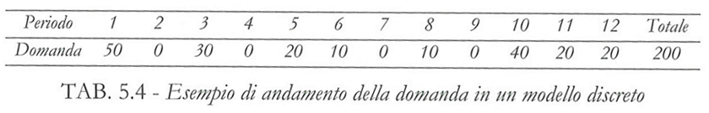
Data used in the following example
N=12 months as time horizon
τ=0 reorder time equal to 0
Purchase and order costs constant in time and in batch size
P=50 unitary purchase cost
f₀=100 cost of one order
c_{m}=0.5 inventory cost for one unit of material per month
demand given below

Slide 4
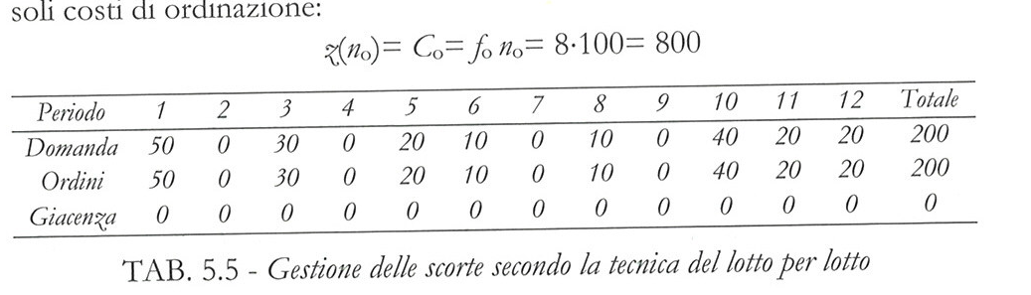
1. Lot-per-lot

Slide 5
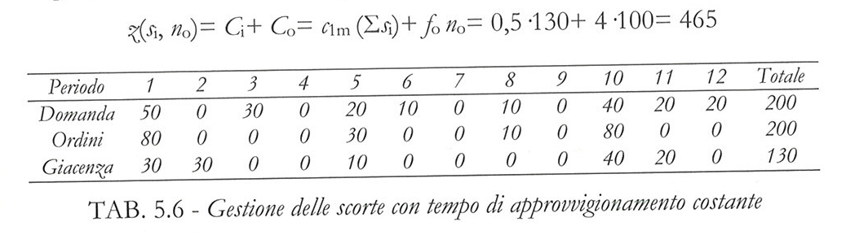
2. Constant order period
Period 3;
If the planned ordered instant the demand is zero, I postpone the order

Slide 6
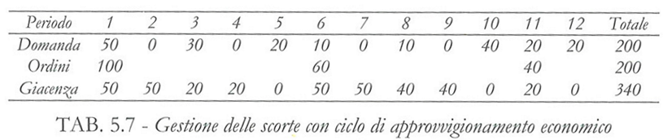
3. Economic feeding
As before, but with T* defined by the economic batch size method

Slide 7
4. Least period cost (Silver & Meal)
It compare batches equal to the sum of increasing periods (1,2,3…).
For each batch, the minimum management cost normalised by the time duration is computed.
The minimum of this normalised cost defines the batch dimension

Slide 8
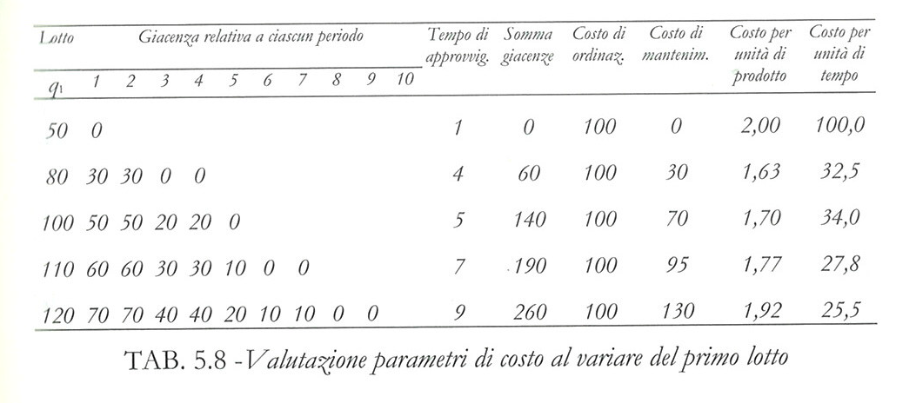
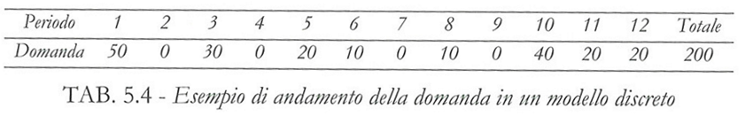

Slide 9
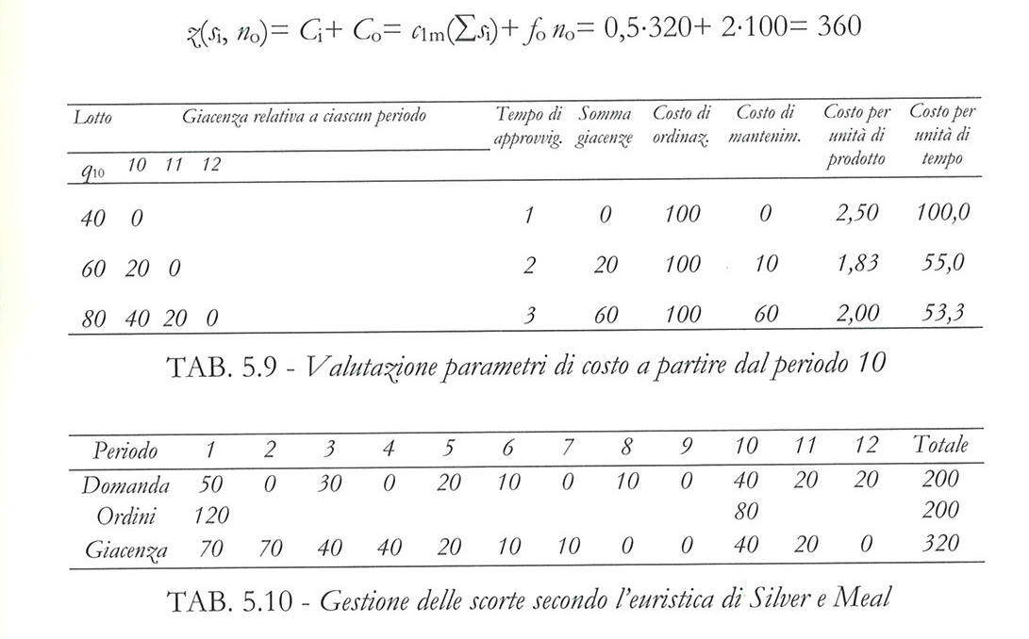

Slide 10
5. Least product cost
As before, but here we take into account the cost normalised by the quantity of product

Slide 11
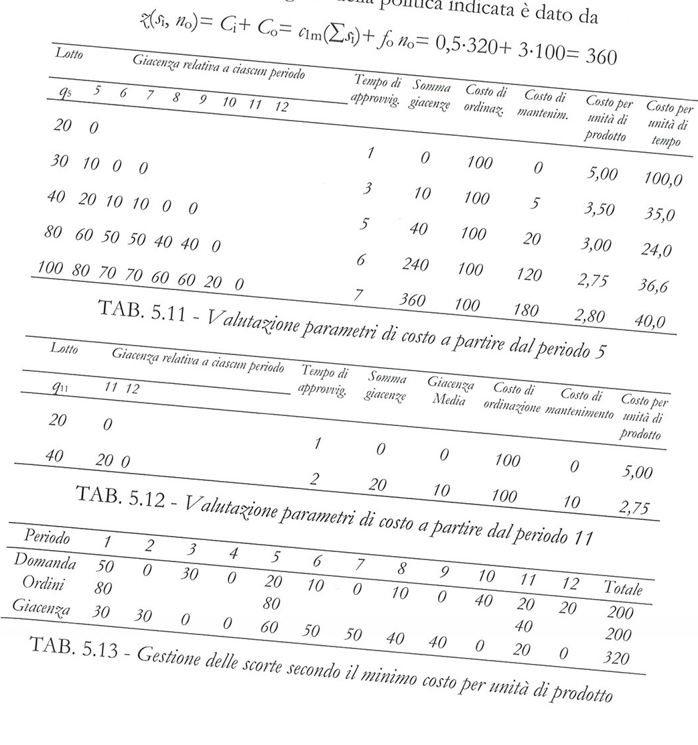

Slide 13
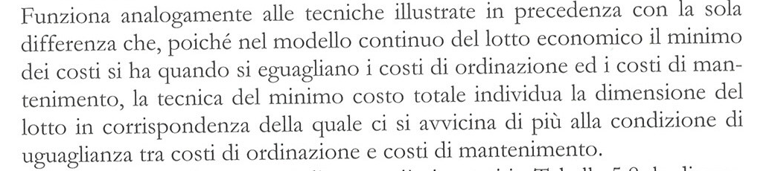
6. Least total cost
As before, but in this case, the optimal dimension has to be chosen when the cost of the order becomes close to the cost of the inventory (as it happens in the economic batch size)

Slide 14
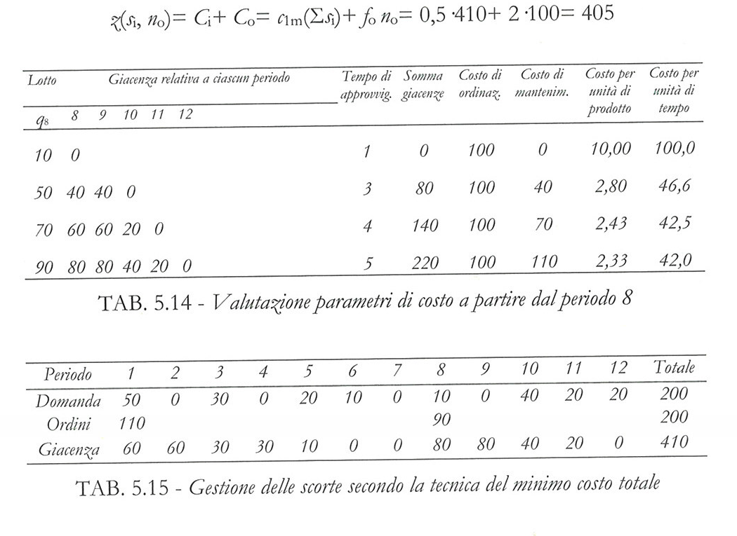

Slide 15


7. Cost balance per period
Similar to the previous one. But in this case we do an order when the level of the inventory is close to:
In the example:

Slide 16
Inventory close to 200

Slide 17
Inventory close to 200

Slide 18
